Slide 1

Modelling Residential-Scale Consumer Demographics using Monthly Electricity Consumption Data
IEEE EPEC 2021
Abdur Rahman, Ameera Arif, Ahmad Nadeem and Dr. Naveed Arshad
Energy Informatics Research Group
Computer Science Department
Lahore University of Management Sciences (LUMS)

Slide 2
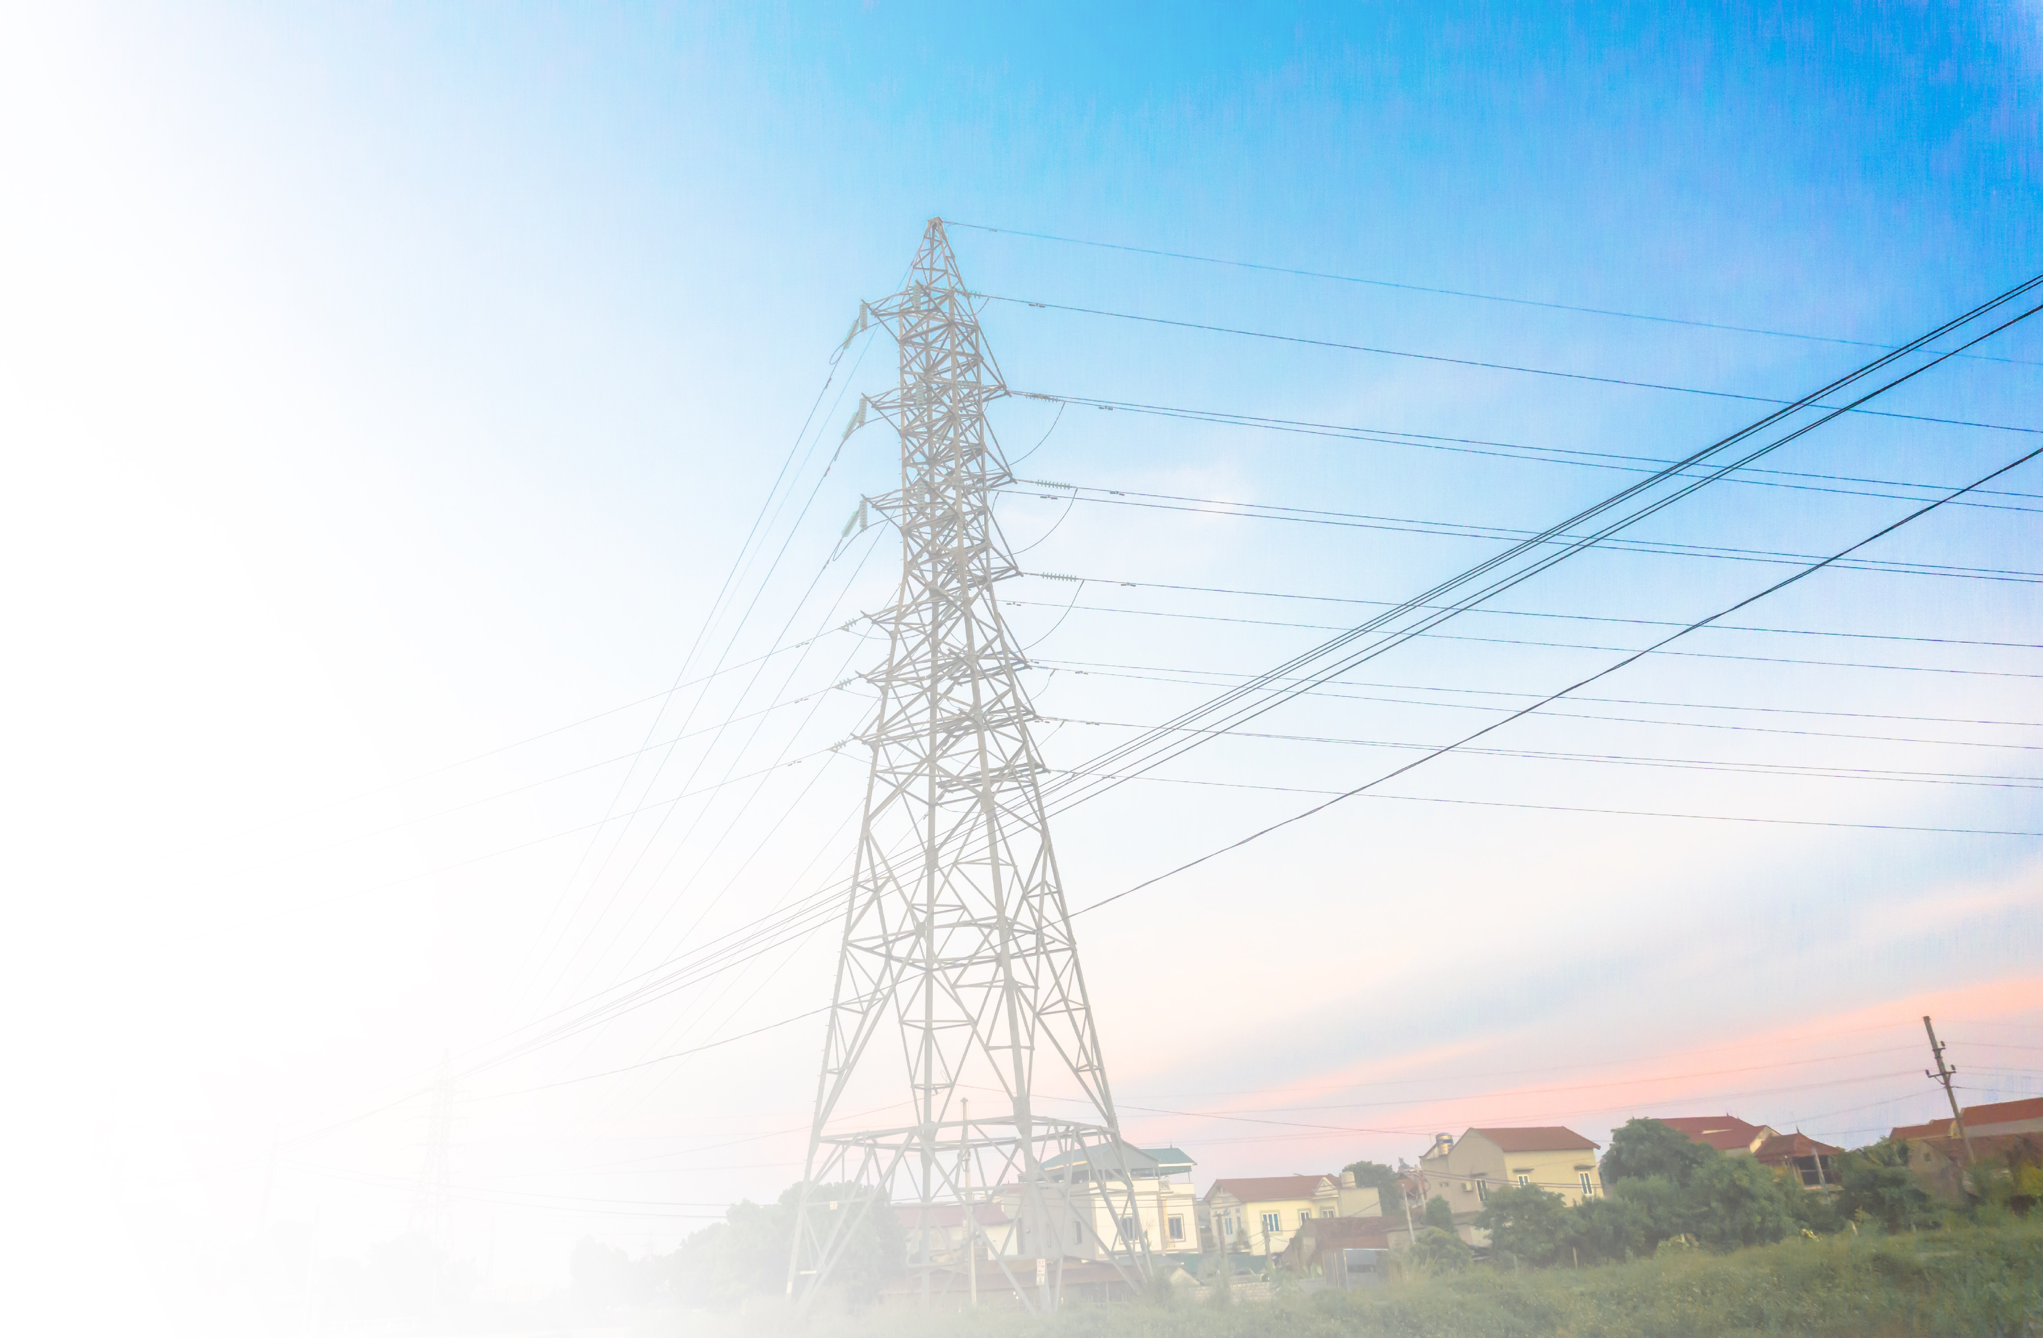
Motivation
Increasing power demands
Problems in energy sector:
- Electricity shortfall
- Overloading of distribution networks
- Load shedding
Development of analytical solutions – Lack of data

Slide 3
Contribution
Prediction of consumer demographics
State of the art
Contribution to energy sector:
- Sound prediction of consumption patterns
- Policy failures and implementation gaps
- Improved development plans
- Power theft

Slide 4
Methodology
Exploratory Data Analysis
Data Cleaning
Modelling
Multivariate Linear Regression
12 predictor variables
Bi-directional selection
Support Vector
Regression
Radial basis function kernel
Type: epsilon regression
Neural
Network
Tuning of number of layers, neurons, learning rates.
Sigmoid activation function
Evaluation

Slide 5
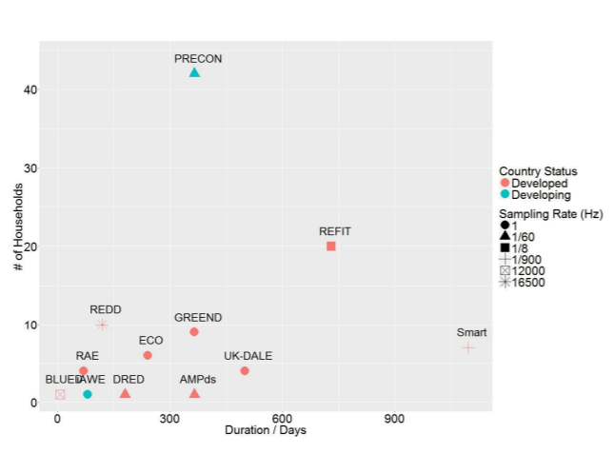
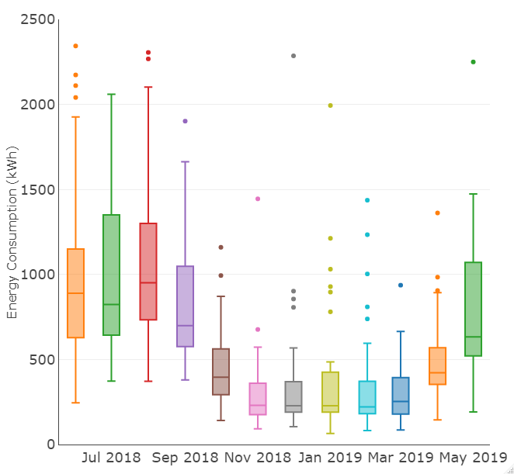
PRECON Dataset
Diversity
Duration
Developing country

Slide 6
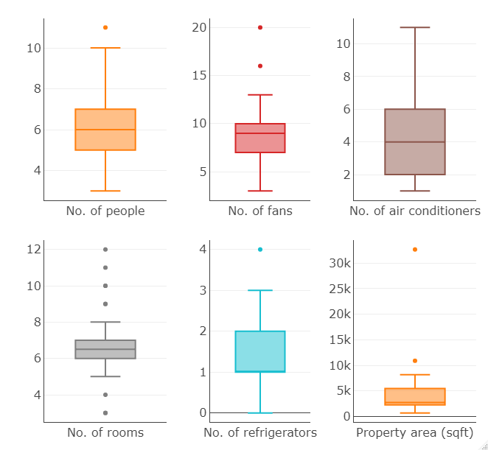
PRECON Dataset
Chosen Parameters:
Number of people
Number of fans
Number of air conditioners
Number of rooms
Number of refrigerators
Property Area (sqft)

Slide 7
Modelling
Modelling
Multivariate Linear Regression
12 predictor variables
Bi-directional selection
Support Vector
Regression
Radial basis function kernel
Type: epsilon regression
Neural
Network
Tuning of number of layers, neurons, learning rates.
Sigmoid activation function
Trained
Model
Electricity consumption of 12 months
One demographic parameter

Slide 8

Evaluation Criteria
Mean Absolute Percentage Error:
MAPE = $\frac{1}{n}\sum_{t=1}^{n}{\left|\frac{A_{t}−P_{t}}{A_{t}}\right|}$
n = number of samples
A = actual value
P = value predicted by model

Slide 9
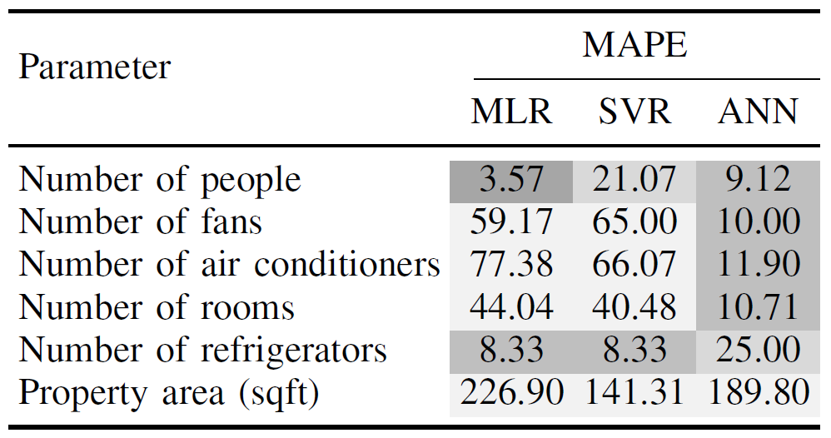
Results

Slide 10
Future work
Expansion of the training dataset
Extension to commercial and industrial consumers
Application of advanced techniques

Slide 11
Questions ?
IEEE EPEC 2021
Modelling Residential-Scale Consumer Demographics using Monthly Electricity Consumption Data
Abdur Rahman¹, Ameera Arif², Ahmad Nadeem³ and Dr. Naveed Arshad⁴
Energy Informatics Research Group (https://web.lums.edu.pk/~eig/)
¹rao.arrn@gmail.com
²ameera.arif09@gmail.com
³ahmad.nadeem@lums.edu.pk
⁴naveedarshad@lums.edu.pk

